Slide 1
Marseilles, IL 61341
Destination Point

Slide 2
Marseilles History
Founded in 1830’s when settlers build a cabin by the Illinois River. The arrival of the Illinois-Michigan Canal (1848), the railroad (1853) , and the Nabisco factory (1902) are also milestones in Marseilles History.
Currently Marseilles is know for the popular attractions, which include Illini State Park and The Middle East Conflicts Wall Memorial.

Slide 3
Art & Preservation
Art & Presentation go hand in hand. These combined enhance real estate values and foster local business keeping communities economically viable.
Historic Buildings are a record of ourselves and our communities.
Historic places also preserve and promote the human stories of people who built, worked, and lived there.

Slide 4
Strengths Business
Interstate 80 Exit
Downtown Business District
Industrial & Manufacturing Businesses
Union Laborers’ Local 393
Lock & Dam
Inland Marine Commerce
Railroad Traffic

Slide 5
Strengths Recreational
The Middle East Conflicts Wall
Illini State Park
Illinois-Michigan Canal
Heritage Corridor Destinations
Recreational River Access & Launch
7 Campgrounds

Slide 6
Strengths Community
Historic Downtown
Community Parks
Churches
Grocery Store
Grade School

Slide 7
Strengths Community Organizations
Marseilles Tourism & Park District
Illinois River Valley Chamber of Commerce
VFW Post 5506
American Légion Auxilliary Post 235
Marseilles Rotary Club No.5313
Marseilles Lions Club
University of Illinois Extension 4H Ribbon Wranglers
Boy Scouts of America 799
Cub Scouts of America 3799
Girl Scouts of America 1201

Slide 8
RurAL TOURISM
University of Illinois Marketing Rural Tourism
By Pam Schallhorn, Community & Economic Development Specialist
Boomtown by Jack Schultz
Leavenworth, WA
New Glarius, WI
Decorah, IA
Pick a Theme for Marseilles, IL

Slide 9
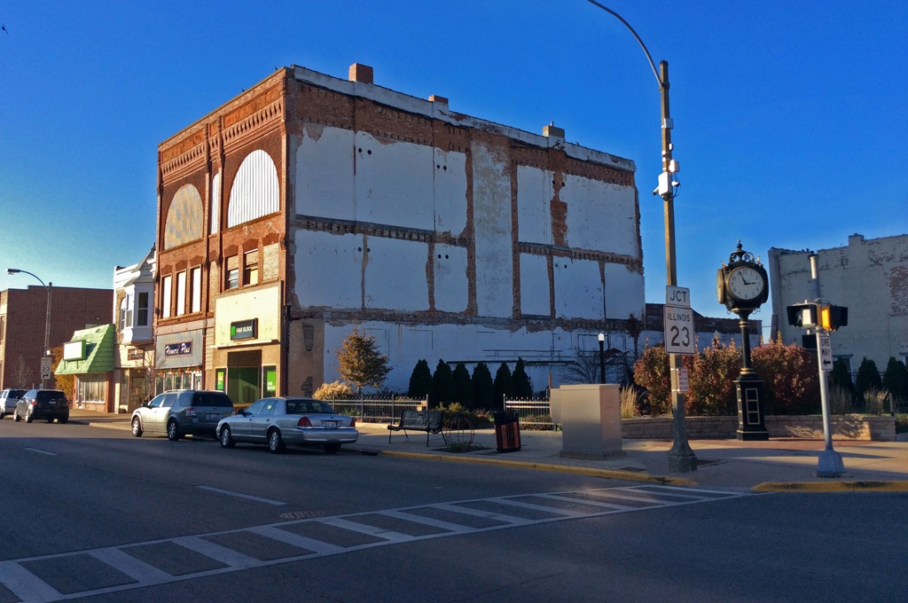
Main & Monroe Streets, Streator, IL
Before

Slide 10
Heritage Park Mural
Upon completion of this mural thirty-six (36) Buildings within two (2) blocks North, South, East and West of the mural have been developed as of October 2016.
Sold to Purchased
Leased Occupied
Façade Renovations
Local business owners Rick & Stephanie Wilkenson invested 2.7 million dollars in a destination venue, Gaetano’s Vault.

Slide 11
Heritage Park Mural
Heritage Park hosts “Music at the Clock” during warm weather months on Friday Nights.
Community members and tourists gather at the mural for family, homecoming, prom, wedding, and overall fun photos!
Featured in the State of Illinois Sesquicentennial Passport 2018 of Things to See

Slide 12
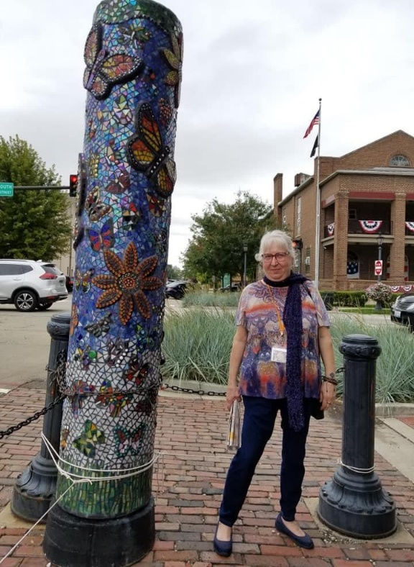
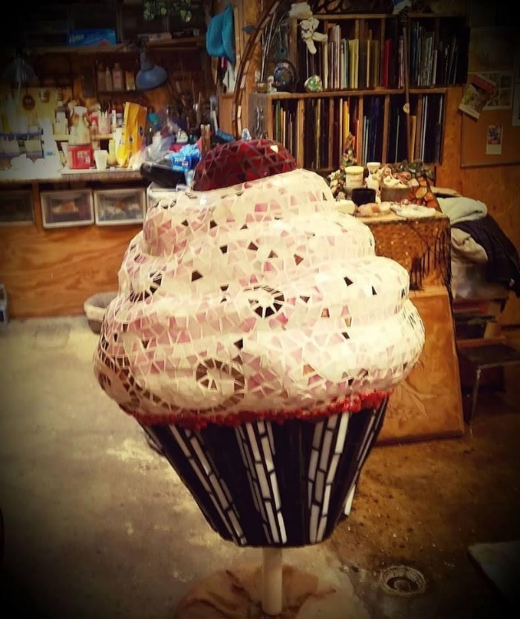
Local Artist
Susan Burton
Renown National Mosaic Artist
Susan Burton uses concrete, metals and mosaics with many different sculptural techniques. Utilizing both natural and manmade materials Burton creates inspiring projects. Her extensive home studio is home to many sculptures throughout her ten acre mini-farm in Ottawa, IL. She loves to challenge herself with new materials and undertakings

Slide 13
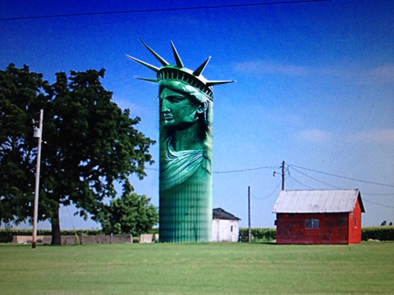
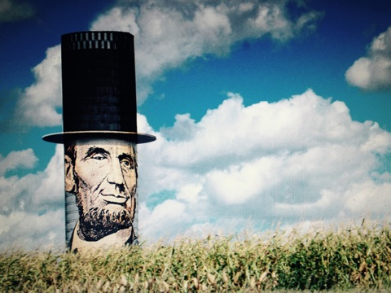
Big Ideas
Lady Liberty
Mr. Lincoln

Slide 14
BIG ART
Droid
Big Corn

Slide 15
BIG ART
Silo
Native American Chief

Slide 16
Recommendations
Pick a Theme
Implement Façade Grant Program
Develop the Raceway
Market in Partnership with Starved Rock State Park, Buffalo Rock, and Matthiessen Park
Develop & Participate in Cross Country Cycling Route
Develop BIG ART
Develop More Recreational and Commercial Inland Marine Commerce
Develop Illinois & Michigan Canal amenities
Address Empty Buildings – it will happen
Connect with Pam Schallhorn, University of Illinois Extension
Follow up Meeting for Data
Involve the Community

Slide 17
Contact US
Here & Again, Inc. 501c3 NPO
DeAnna Carlson
Director
815.488.6611 Mobile Direct
carlsonoffice61370@gmail.com
Katie Troccoli
Founder
815.228.2058 Mobile Direct
katiet1@sbcglobal.net

